Slide 1

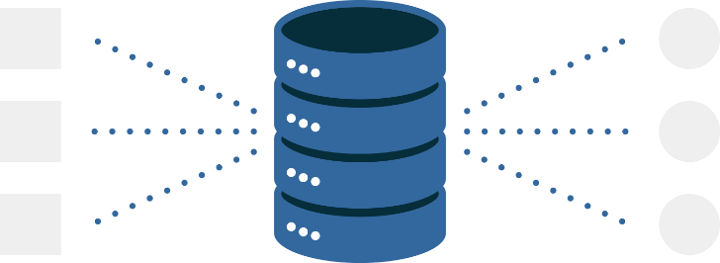
Map Reduce
Lecture 13
Fahad Maqbool
Department of Computer Science

Slide 2
Motivation
How to distribute computation?
Distributed/parallel programming is hard
Map-reduce addresses all of the above
Google’s computational/data manipulation model
Elegant way to work with big data

Slide 3
Motivation
20+ billion web pages x 20KB = 400+ TB
1 computer reads 30-35 MB/sec from disk
~4 months to read the web
~1,000 hard drives to store the web
It takes even more to do something useful with the data!
Today, a standard architecture for such problems is emerging:
Cluster of commodity Linux nodes
Commodity network (ethernet) to connect them

Slide 4
Single Node Architecture
CPU
Machine Learning, Statistics
Memory
“Classical” Data Mining
Disk

Slide 5
Cluster Architecture
2-10 Gbps backbone between racks
1 Gbps between
any pair of nodes
in a rack
Switch
Switch
Switch
CPU
CPU
CPU
CPU
Mem
…
Mem
Mem
…
Mem
Disk
Disk
Disk
Disk
Each rack contains 16-64 nodes
In 2011 it was guestimated that Google had 1M machines, http://bit.ly/Shh0RO

Slide 6
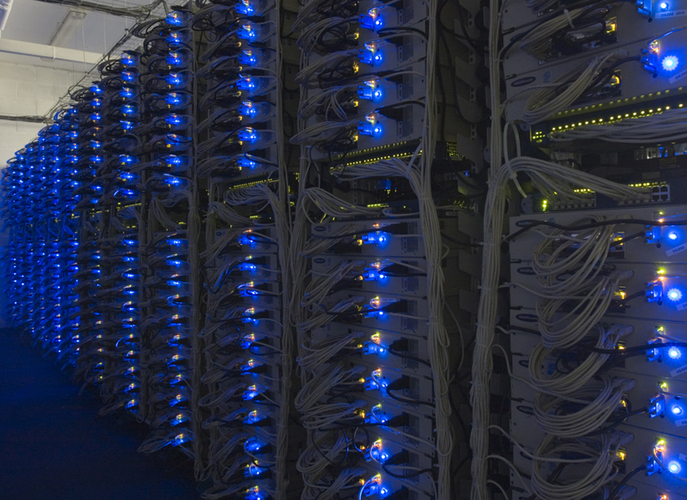

Slide 7
Large Scale Computing
Large-scale computing for data mining problems on commodity hardware
Challenges:
How do you distribute computation?
How can we make it easy to write distributed programs?
Machines fail:
One server may stay up 3 years (1,000 days)
If you have 1,000 servers, expect to loose 1/day
People estimated Google had ~1M machines in 2011
1,000 machines fail every day!

Slide 8
Idea & Solution
Issue: Copying data over a network takes time
Idea:
Bring computation close to the data
Store files multiple times for reliability
Map-reduce addresses these problems
Google’s computational/data manipulation model
Elegant way to work with big data
Storage Infrastructure – File system
Google: GFS. Hadoop: HDFS
Programming model
Map-Reduce

Slide 9
Storage Infrastructure
Problem:
If nodes fail, how to store data persistently?
Answer:
Distributed File System:
Provides global file namespace
Google GFS; Hadoop HDFS;
Typical usage pattern
Huge files (100s of GB to TB)
Data is rarely updated in place
Reads and appends are common

Slide 10
Distributed File System
Chunk servers
File is split into contiguous chunks
Typically each chunk is 16-64MB
Each chunk replicated (usually 2x or 3x)
Try to keep replicas in different racks
Master node
a.k.a. Name Node in Hadoop’s HDFS
Stores metadata about where files are stored
Might be replicated
Client library for file access
Talks to master to find chunk servers
Connects directly to chunk servers to access data

Slide 11
Distributed File System
Reliable distributed file system
Data kept in “chunks” spread across machines
Each chunk replicated on different machines
Seamless recovery from disk or machine failure
C₀
C₁
D₀
C₁
C₂
C₅
C₀
C₅
…
C₅
Chunk server 1
C₂
C₅
Chunk server 2
C₃
D₀
Chunk server 3
D₁
D₀
Chunk server N
C₂
Bring computation directly to the data!
Chunk servers also serve as compute servers

